Slide 1






Problem Statement ID – KH26-ECE-16
Problem Statement Title- Distributed Flood and Landslide Early-Warning Network
Theme- Disaster Management & Public Safety using IoT + AI
PS Category- Hardware
Team ID- 41
Team Name (Registered on portal)

Slide 2
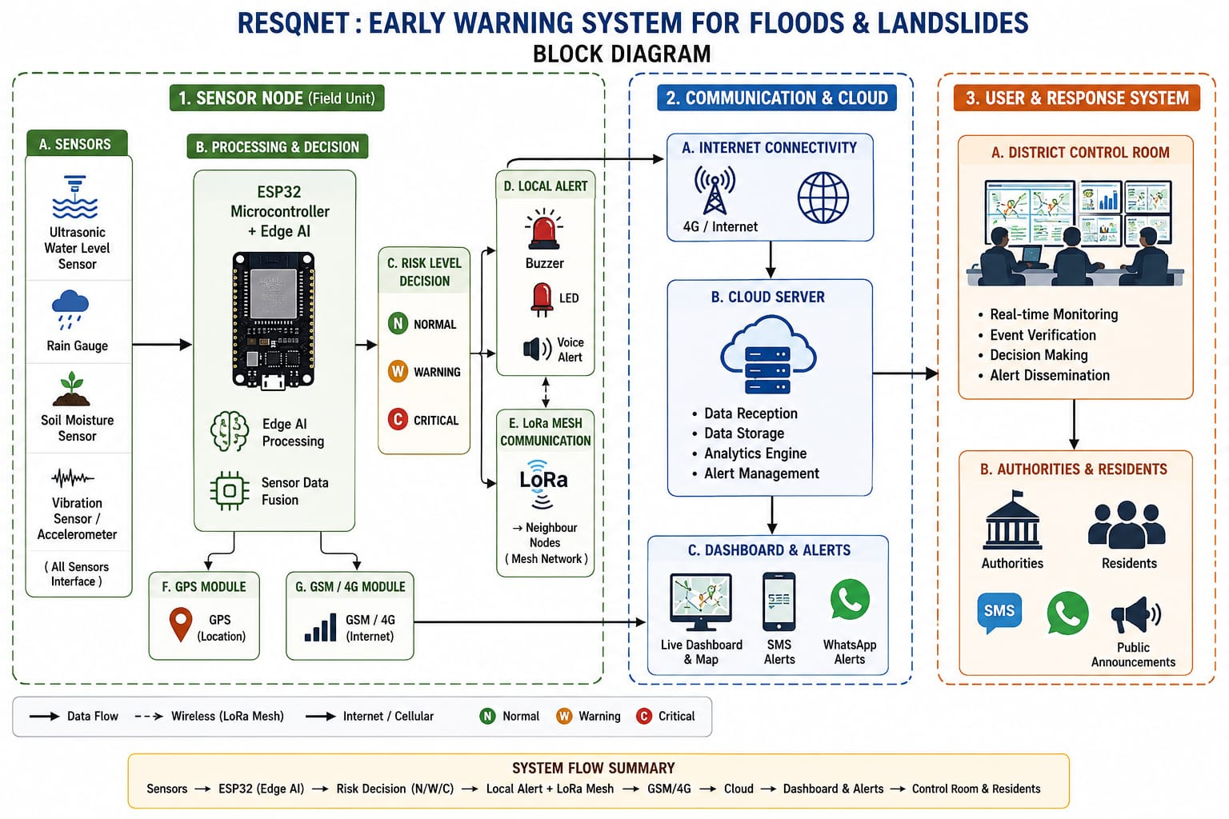
IDEA TITLE
Proposed Solution
The Belowed Block Diagram Explians The Detailed Explanation Of The Proposed Solution And Adress The Problem And Innovation And Uniqueness Of The Solution:

Slide 3
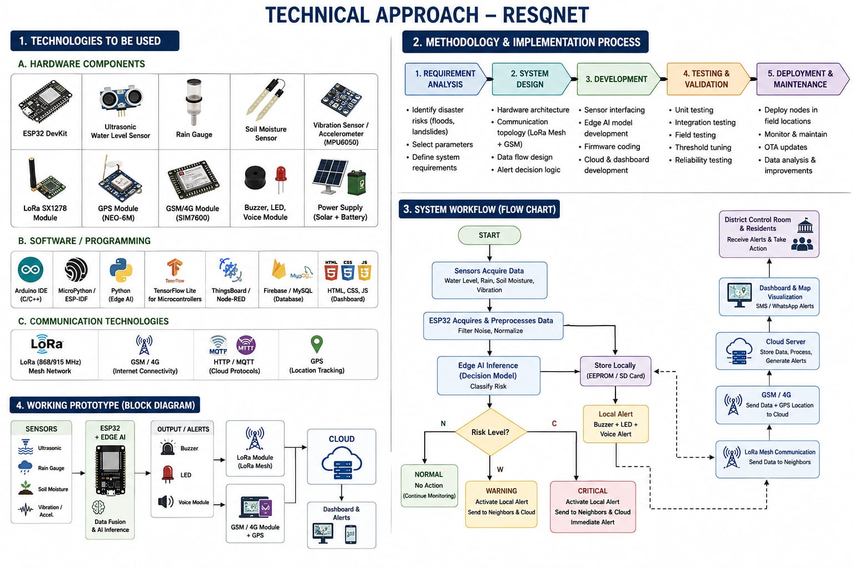
TECHNICAL APPROACH

Slide 4
FEASIBILITY AND VIABILITY
Analysis of the Feasibility of the Idea:
RESQNET is technically, economically, and operationally feasible because it uses low-cost, widely available IoT components and combines them with Edge AI, LoRa communication, GPS, and GSM/4G connectivity.
Technical Feasibility
Economic Feasibility
Operational Feasibility
Overall Viability
Sensors → Edge AI → Risk Detection → Local/LoRa Alert → GSM/4G → Cloud → Dashboard →
Authorities & Residents
These architecture makes RESQNET suitable for remote, flood-prone and landslide-prone areas, particularly where conventional communication infrastructure may be unreliable
2. CHALLENGES & RISKS → POSSIBLE IMPACT:
Sensor Errors → Inaccurate Detection | False Alarms → Unnecessary Alerts | Network Failure → Delayed Communication | Power Issues → System Shutdown | Weather Damage → Hardware Failure | AI Errors → Wrong Prediction | Cybersecurity Risks → Data Loss | Maintenance Issues → Reduced Reliability.

Slide 5
FEASIBILITY AND VIABILITY
3. Strategies for Overcoming the Challenges:
Improve Sensor Reliability
Reduce False Alarms
Provide Communication Redundancy
Ensure Power Availability
Protect Hardware
Improve AI Reliability
Local Data Backup
Cybersecurity
Regular Maintenance
Scalable Deployment
4.Feasibility Summary:
RESQNET is viable because it combines:
Low-cost hardware + Multi-sensor monitoring + Edge AI + LoRa mesh + GSM/4G + GPS + Cloud dashboard + Multi-level alerts
The combination provides a scalable, decentralized and resilient early-warning approach that can continue providing local warnings even when external communication infrastructure is temporarily unavailable.

Slide 6
IMPACT AND BENEFITS
1.Potential Impact on Target Audience
Early Detection → Faster Alerts → Quick Response → Reduced Losses → Safer Communities
2.Social Impact
Early Warning → Public Safety → Reduced Casualties → Improved Disaster Preparedness
3.Economic Impact
Early Detection → Reduced Property & Infrastructure Damage → Lower Recovery Costs → Reduced Financial Loss
4.Environmental Impact
Continuous Monitoring → Early Detection of Floods/Landslides → Reduced Environmental Damage → Better Ecosystem Protection
5.Solution Benefits
Low-Cost System → Real-Time Monitoring → Edge-AI Detection → LoRa Mesh Connectivity → Scalable & Reliable Disaster Management
6.Overall Impact
RESQNET → Early Warning → Faster Emergency Response → Safer People + Reduced Economic Loss + Environmental Protection

Slide 7
.
  THANK YOU

